Slide 1

Applicant Taster Day
DIG 5125 – Digital Media Processing
Dr Sam Smith samuel.smith@bcu.ac.uk

Slide 2
Why Digital Media Processing?
Fundamentals of image and video processing and manipulation
How techniques can be developed using core principles
Technical module with practical coding and theory
Digital Media Processing – Lecture 01: Introduction Dr Samuel Smith – Samuel.smith@bcu.ac.uk

Slide 3
Application Areas
We will study key principles related to:
Image manipulation
Interface/Interaction systems
Segmentation and tracking systems
Image processing systems
Medical image analysis
Weekly practical and theoretical sessions, with tutorial/lecture based content
Digital Media Processing – Lecture 01: Introduction Dr Samuel Smith – Samuel.smith@bcu.ac.uk

Slide 4
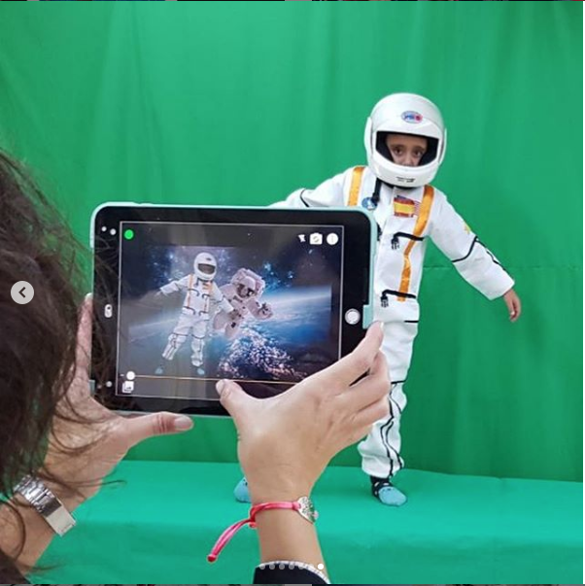
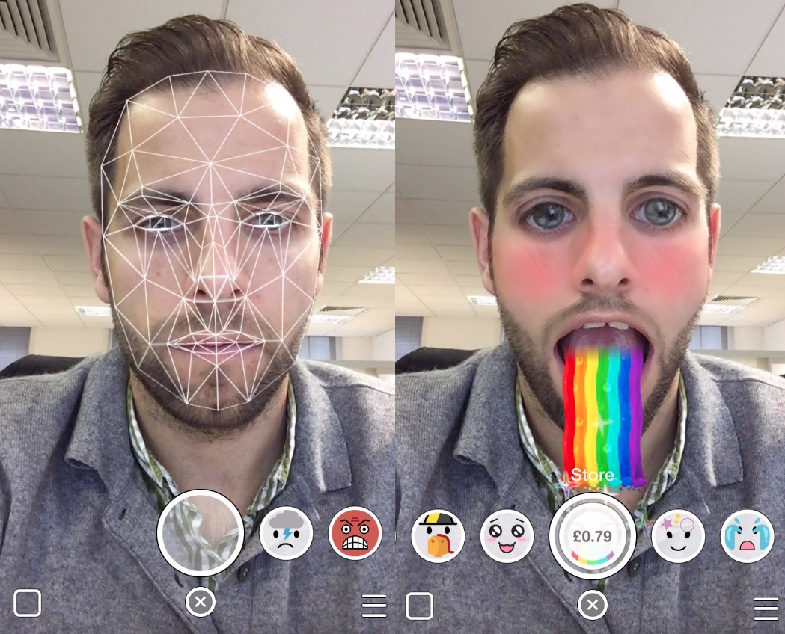
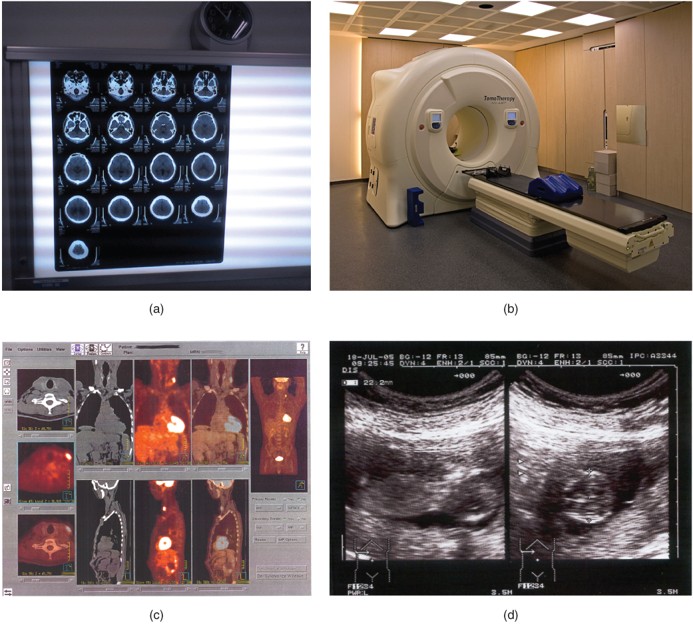

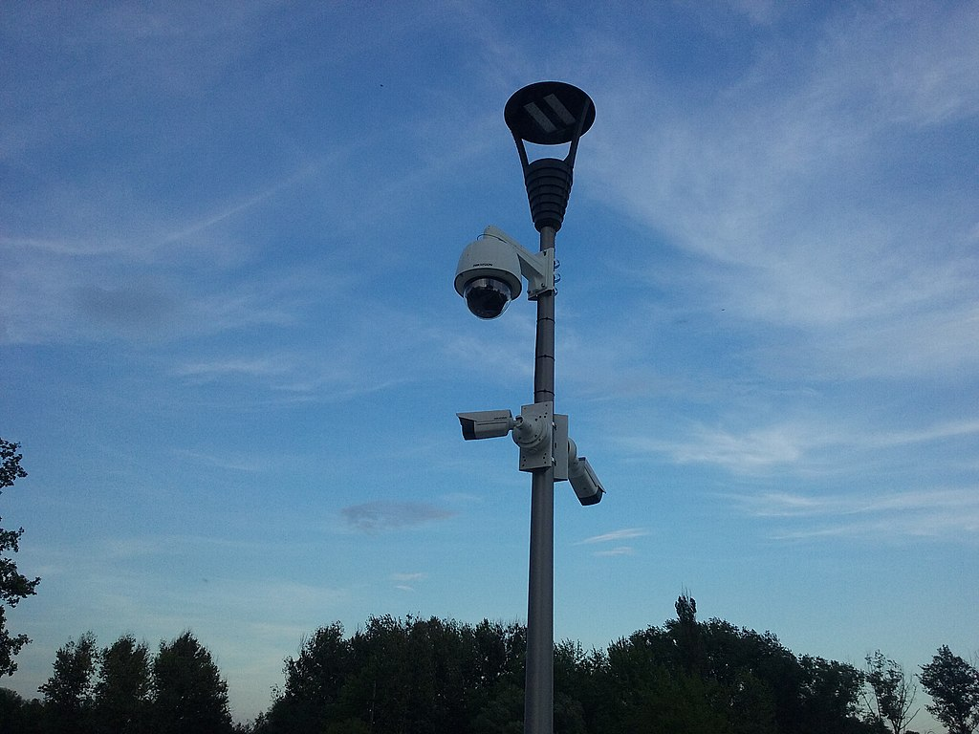
Examples
© ChromaVid
© Snapchat
© Photoshop
© Wikimedia Commons
© Wikimedia Commons – Medical Image Processing
Digital Media Processing – Lecture 01: Introduction Dr Samuel Smith – Samuel.smith@bcu.ac.uk

Slide 5
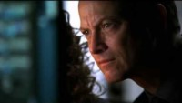
Image Processing - Movies
Digital Media Processing – Lecture 01: Introduction Dr Samuel Smith – Samuel.smith@bcu.ac.uk

Slide 6

Image Processing - Reality
Digital Media Processing – Lecture 01: Introduction Dr Samuel Smith – Samuel.smith@bcu.ac.uk

Slide 7
What is a Digital Image?
Digital Image: A numerical representation of quantised image data
Quantised: Finite representation of numeric data which is approximated to the resolution of a particular system
Digital Media Processing – Lecture 01: Introduction Dr Samuel Smith – Samuel.smith@bcu.ac.uk
Notes:
By Quantised we mean finite, basically a representation of numeric data that is approximated to the resolution of the system where they were captured or where they are displayed.

Slide 8
What is a Finite Digital?
Finite is the opposite to “infinite” meaning to be endless
Therefore Finite is defined as having a limited range
If we look closer at a digital image we will see that is made up of a limited (finite) number of pixels
Each pixel will have a value associated with it
The values associated to each pixel will be “finite” (a specific number in a defined range)
Digital Media Processing – Lecture 01: Introduction Dr Samuel Smith – Samuel.smith@bcu.ac.uk
Notes:
What we mean with finite, basically the opposite of infinite, which is endless. Finite is defined as having a limited range,

Slide 9
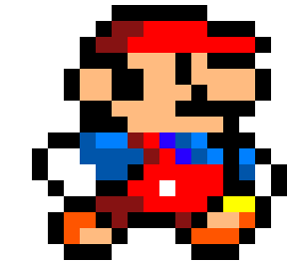
Digital Image Representation
Therefore we represent images as a two dimensional function f(x, y)
Where x and y are spatial coordinates
The amplitude of f at any pair of coordinates is called intensity or grey level
x
Note that a digital image is composed of a finite number of elements, each of which has a particular location and value – These are called pixels
y
Digital Media Processing – Lecture 01: Introduction Dr Samuel Smith – Samuel.smith@bcu.ac.uk

Slide 10
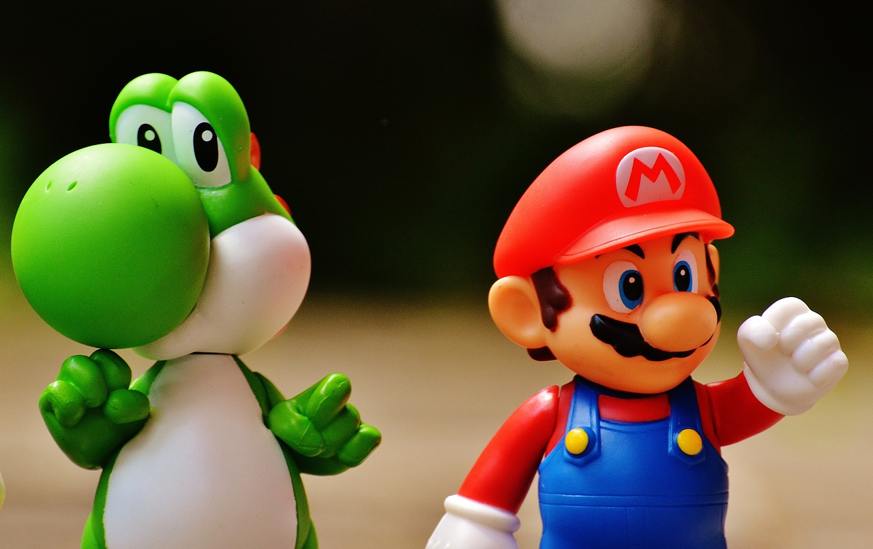
Image Types
Binary Images
Greyscale Images
RGB Images
x = 1280
x = 1280
x = 1280
y = 806
y = 806
y = 806
1 bit – 2 colours [0,1]
8 bit – 256 colours [0-255]
24 bit – 8 bit per channel [R,G,B]
0 | 1 | 1
1 | 0 | 1
0 | 0 | 0
255 | 244 | 251
243 | 211 | 123
212 | 24 | 55
255 | 244 | 251
243 | 211 | 123
212 | 24 | 55
255 | 244 | 251
243 | 211 | 123
212 | 24 | 55
255 | 244 | 251
243 | 211 | 123
212 | 24 | 55
R - red
G - green
B - blue
Digital Media Processing – Lecture 01: Introduction Dr Maite Frutos – maite.frutos@bcu.ac.uk

Slide 11
Image Processing – Zoom And Enhance in MATLAB
Import Image into software
Zoom and Crop
Upscale – Interpolation
Enhance – Sharpening filter
Digital Media Processing – Lecture 01: Introduction Dr Samuel Smith – Samuel.smith@bcu.ac.uk

Slide 12

Image Handling – Import Image
IMG = imread(‘mario.jpg’);
%Read in the image to variable I
imshow(IMG);
%show the image figure, imshow(I);
The script applies two key functions: imread and imshow
Imread takes the string argument of the local image filename and stores the image data into variable I
Digital Media Processing – Lecture 01: Introduction Dr Samuel Smith – Samuel.smith@bcu.ac.uk

Slide 13
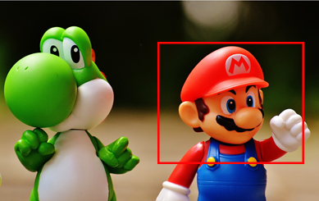
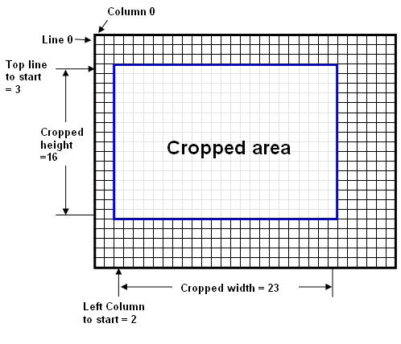
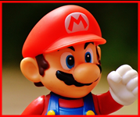
Zoom and Crop
Zooming and Cropping is a simple process
Every pixel has an index (A label that describes the pixel location)
We just select which pixels we wish to examine and discard the rest
Digital Media Processing – Lecture 01: Introduction Dr Samuel Smith – Samuel.smith@bcu.ac.uk

Slide 14
Zoom and Crop -MATLAB
figure, imshow(IMG)
% Calculate image dimensions
[r,c,z]=size(IMG);
%Define region size Px x Px
Px = 15;
% Select pixel in image
[x, y] = ginput(1);
% Calculate region around selected pixel of size Px
xdims =max(1,round(x-Px/2)):min(round(x+Px/2),c);
ydims = max(1,round(y-Px/2)):min(round(y+Px/2),r);
%Create cropped image
ZoomIMG=IMG(ydims,xdims,1:3);
Digital Media Processing – Lecture 01: Introduction Dr Samuel Smith – Samuel.smith@bcu.ac.uk

Slide 15
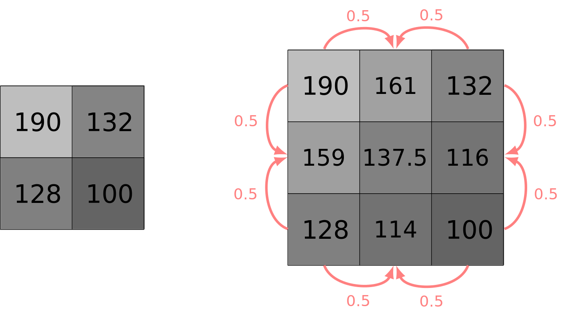
Enhance – Upscaling
We can increase pixel resolution by upscaling an image
We create new pixels and insert them between adjacent pixels with values between that of neighbouring pixels
Digital Media Processing – Lecture 01: Introduction Dr Samuel Smith – Samuel.smith@bcu.ac.uk

Slide 16

Enhance – Upscaling
% Enhance = interpolate
upscale_factor =3;
ImgEnhancedRedCh =interp2(double(ZoomIMG(:,:,1)),upscale_factor);
ImgEnhancedGreenCh =interp2(double(ZoomIMG(:,:,2)),upscale_factor);
ImgEnhancedBlueCh =interp2(double(ZoomIMG(:,:,3)),upscale_factor);
EnhancedIMG(:,:,1)=ImgEnhancedRedCh;
EnhancedIMG(:,:,2)=ImgEnhancedGreenCh;
EnhancedIMG(:,:,3)=ImgEnhancedBlueCh;
Digital Media Processing – Lecture 01: Introduction Dr Samuel Smith – Samuel.smith@bcu.ac.uk

Slide 17
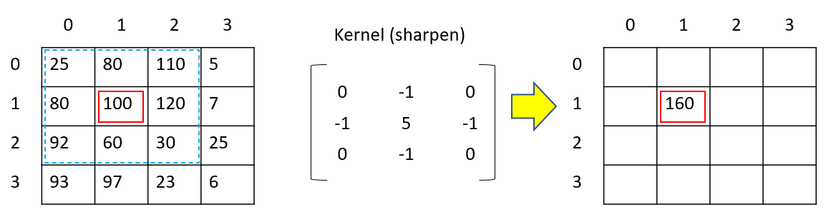
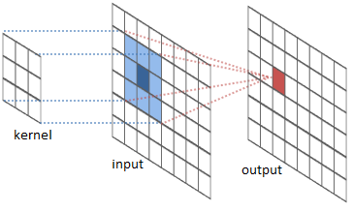
Enhance – Sharpening filter
After upscaling, the image may appear blurry
To compensate we can apply a sharpening filter
Filters use a linear process called convolution which uses addition and multiplication
There’s far too much to cover on filtering in this session
Digital Media Processing – Lecture 01: Introduction Dr Samuel Smith – Samuel.smith@bcu.ac.uk

Slide 18
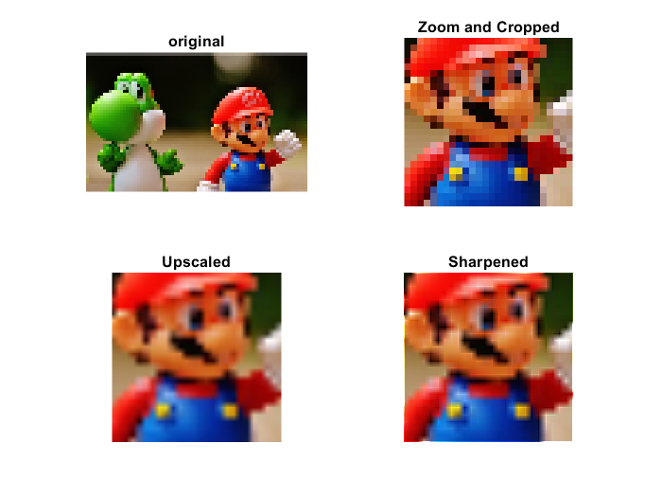
Enhance – Sharpening filter
There are several different filtering methods which we can apply
Each have different advantages and disadvantages
Today we will use the MATLAB built in filtering function
%Create sharpening filter kernel
h = [0, -1, 0; -1, 5, -1; 0, -1, 0];
% Apply filter using convolution
SharpenedIMG = imfilter(EnhancedIMG, h);
Digital Media Processing – Lecture 01: Introduction Dr Samuel Smith – Samuel.smith@bcu.ac.uk

Slide 19
Download script and test image
Download MATLAB script from https://github.com/samdsmithuk/ATD
Log into computers and launch Matlab
Digital Media Processing – Lecture 01: Introduction Dr Samuel Smith – Samuel.smith@bcu.ac.uk

